Slide 1

Service A
API
Web Service
Service B
How software architecture defines boundaries and APIs bridge them
Fabian Mauz

Slide 2
How software architecture defines boundaries and APIs bridge them
Roadmap
Definition and Motivation
Example : Microservices
Example : Ports and Adapters
Architecture
Softwarearchitecture: What and Why
Examples : Microservices and Hexagonal architecture
What is an API 2 Examples
Open API
Testing APIs

Slide 3
How software architecture defines boundaries and APIs bridge them
Roadmap
Definition and Motivation
Example : Microservices
Example : Ports and Adapters
Architecture
A definition from reality
Examples : Java Interface & REST
Open API
APIs
Softwarearchitecture: What and Why
Examples : Microservices and Hexagonal architecture
What is an API 2 Examples
Open API
Testing APIs

Slide 4
How software architecture defines boundaries and APIs bridge them
Roadmap
Definition and Motivation
Example : Microservices
Example : Ports and Adapters
Architecture
A definition from reality
Examples : Java Interface & REST
Open API
APIs
Security
Testing APIs with good architecture
Github Actions
Tools & Tipps
Softwarearchitecture: What and Why
Examples : Microservices and Hexagonal architecture
What is an API 2 Examples
Open API
Testing APIs

Slide 5
How software architecture defines boundaries and APIs bridge them
What is software architecture?
The software architecture of a program or computing
system is the structure or structures of the system,
which comprise software components, the externally
visible properties of those components, and the relationships
among them
[1]
[1] L. Bass, P. Clements and R. Kazman. Software Architecture in Practice. Addison Wesley, 1999, ISBN 0-201-19930-0.

Slide 6
How software architecture defines boundaries and APIs bridge them
What is software architecture?
The software architecture of a program or computing
system is the structure or structures of the system,
which comprise software components, the externally
visible properties of those components, and the relationships
among them
[1]
[1] L. Bass, P. Clements and R. Kazman. Software Architecture in Practice. Addison Wesley, 1999, ISBN 0-201-19930-0.

Slide 7



How software architecture defines boundaries and APIs bridge them
What is software architecture?
„The goal of software architecture is to minimize the human resources required to build and maintain the required system“
Robert C. Martin, Clean Architecture, 2017
Robert C. Martin
Martin Fowler
„Software architecture is those decisions which are both important and hard to change “
Martin Fowler
„Architecture represents the significant design decisions that shape a system, where significant is measured by cost of change “
Grady Booch
Grady Booch

Slide 8
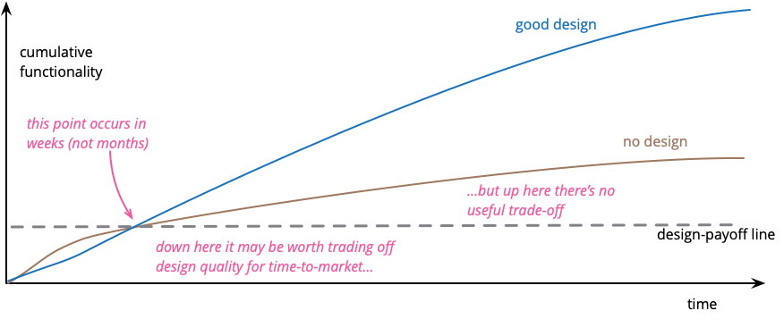
How software architecture defines boundaries and APIs bridge them
Why thinking about architecture?
M. Fowler, Design Stamina Hypothesis, 2007

Slide 9
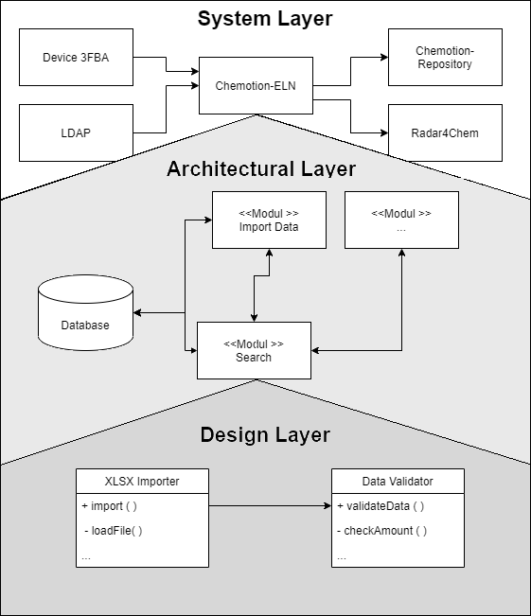
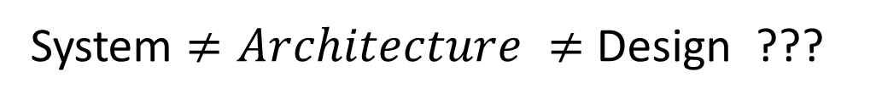
How software architecture defines boundaries and APIs bridge them
Why thinking about architecture?
System $≠Architecture ≠$ Design ???
M. Fowler, Design Stamina Hypothesis, 2007

Slide 10

How software architecture defines boundaries and APIs bridge them
Dependencies
One main problem to change software are dependencies
Query: EC 1.1.1.1
BRENDA
Algorithm A
Data Provider A
How difficult is it to change the data provider ???

Slide 11
How software architecture defines boundaries and APIs bridge them
Dependencies
One main problem to change software are dependencies
Data Provider A
BRENDA
Query: EC 1.1.1.1
Algorithm A
Data Provider B
STRENDA-DB
How difficult is it to change the data provider ???

Slide 12
How software architecture defines boundaries and APIs bridge them
Coupling
One main problem to change software are dependencies
Data Provider A
UniProtKB
Query: EC 1.1.1.1
Algorithm A
Data Provider B
ENZYME
Loose Coupling
Interfaces
APIs
Content
Domain
Boundries
Datastructure
Function calls

Slide 13
How software architecture defines boundaries and APIs bridge them
Microservice architecture
Small independent, specialized services
Own isolated data persistence
Communication takes place via well-defined APIs
UI
Service 1
Service 2
The good
The bad
„Small“ codebase, can be implemented independently
High scalability
Technological flexibility
Reliability
More complex than monolith
Deployment more complex
Data Consistency
Communication slower
DB 1
Service 3
DB 2
O.Al-Debagy, P.Martinek, A Comparative Review of Microservices and Monolithic Architectures, 2018

Slide 14
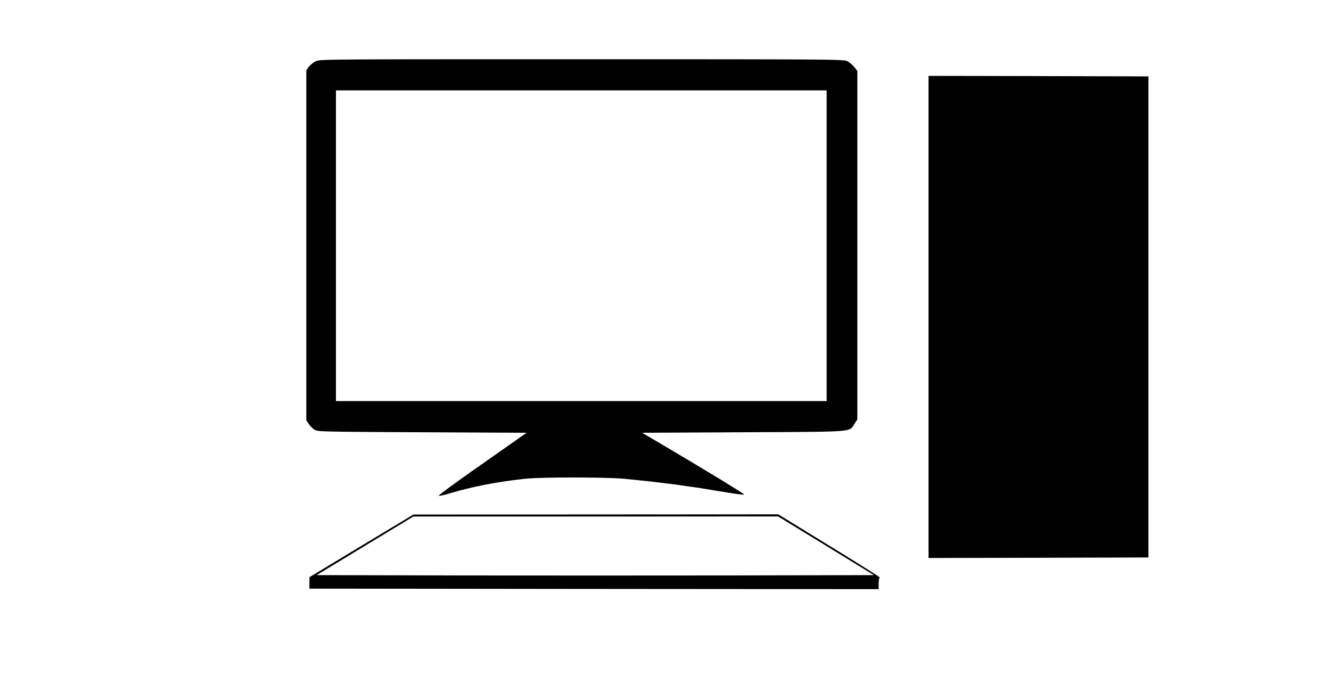
How software architecture defines boundaries and APIs bridge them
Microservice architecture – Examples
Service 1
Service 3
Service 2
https
Reverse Proxy
User
Backend
JDBC
Chemical aware Postgres
Webfrontend
REST
REST
Service n+1
Service n
Calculation/Predicting
Service

Slide 15
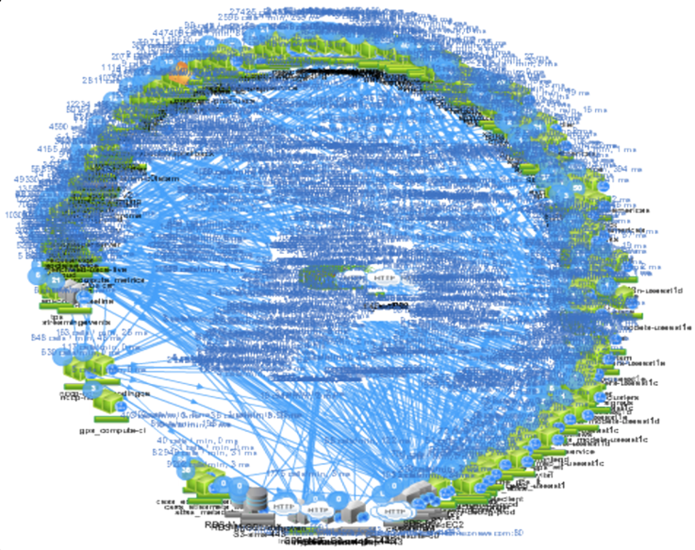
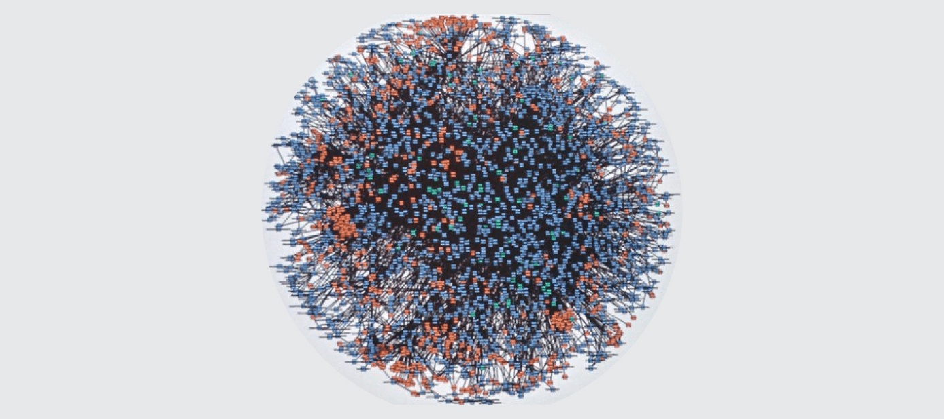
How software architecture defines boundaries and APIs bridge them
Microservice architecture – Examples - Netflix & Amazon
^{Amazon, 2000}
„Microservices and serverless components are tools that do work at high scale, but whether to use them over monolith has to be made on a case-by-case basis”
Netflix-Death-Star Architecture
Amazon claims to have reduced the cost of its video streaming service by 90% by switching from a microservice/serverless architecture to a monolith
Marcin Kolney, Amazon Prime Senior Software Development Engineer

Slide 16

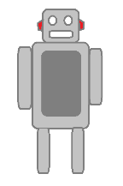
How software architecture defines boundaries and APIs bridge them
Ports and Adapters/Hexagonal architecture
ENZYME
ML – Tool 1
Adapters
ML – Tool 2
REST
Port
REST
Project DB
JPA
Core Ideas
Port
Port
REST
Application
Business logic is isolated from infrastructure
Changing infrastructure does not effect BL
Infrastructure and BL communicate with ports and adapters (loose coupling)
Primary (triggers an usecase) and Secondary Actors
Port
UI
Test
Alister Cockburn
User
https://alistair.cockburn.us/hexagonal-architecture/, 2005

Slide 17
How software architecture defines boundaries and APIs bridge them
Ports and Adapters – Example
UseCase : Search for molecule with substructure search
User
Postgres
REST
JPA
TEST
Port
Port
UseCase

Slide 18
How software architecture defines boundaries and APIs bridge them
Ports and Adapters – Example
UseCase : Search for molecule with substructure search
User
Postgres
<< REST >>
MoleculeSearch
<<Class>>
MoleculeSearchService
<< Junit >>
MoleculeSearchServiceTest
uses
<< Interface >>
MoleculeSearchPort
<< Interface >>
MolecularSearchRepositoryPort
implements
implements
uses
<< class >>
MolecularSearchUseCase

Slide 19
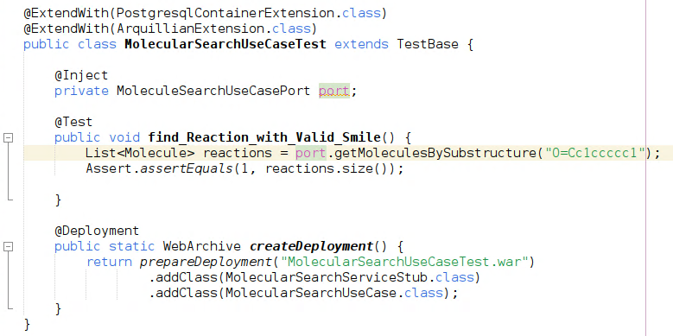
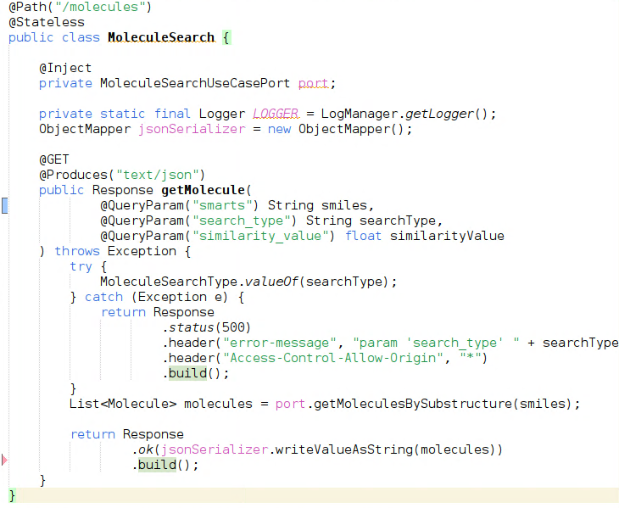




How software architecture defines boundaries and APIs bridge them
Ports and Adapters – Example
Adaper – Junit Test
Adaper – REST
It‘s me again.
Still thinking about how difficult it is to change the dependency ???

Slide 20


How software architecture defines boundaries and APIs bridge them
Ports and Adapters – Example
Adaper – Junit Test
Adaper – REST
Wow
That was easy !!!

Slide 21
How software architecture defines boundaries and APIs bridge them
API – A practical definition
Both architectures define boundaries
Adapters and application are
conceptually separated from each other
Services are conceptually and often physically separated from each other
Service
Service
Service
Communication over a function call defined by an interface
Communication over a network based protocol like REST or JDBC

Slide 22
How software architecture defines boundaries and APIs bridge them
API – A practical definition
Both architectures define boundaries
Adapters and application are
conceptually separated from each other
Services are conceptually and often physically separated from each other
Can we find a definition that does justice to both
??
Service
Service
Service
Communication over a function call defined by an interface
Communication over a network based protocol like REST or JDBC

Slide 23
How software architecture defines boundaries and APIs bridge them
API – A practical definition
API – Application programming interface
both represent an abstraction of the underlying implementation
both introduce a specification of the required and supplied data
both define a semantics or a behavior of the exchange
Domain
Signature
Service
Service
Protocol
Service
J. Gough, D Bryant, M Auburn, Mastering API Architecture,2023, S. XXV

Slide 24
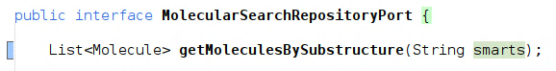
How software architecture defines boundaries and APIs bridge them
API - Java function call defined by an interface
The keywords and the environment (java) defines the protocol
The naming of the method and parameters indicates it‘s functionallity
Protocol
Domain
There is no statement about how something is done only what
There is no indication of whether the request is idempotent.(Idempotent calls would return each time the same result. This can be defined in part by the protocol type)
Signature
The method name,input and output arguments and their types

Slide 25
How software architecture defines boundaries and APIs bridge them
API – REST Definition
REST : Representational State Transfer
Not a standard or protocol, like HTTP but more of a style
Protocol: Not strictly defined but in reality, 99% http(s)
Set of rules/constraints
Domain: domain specific resources
Client-server
Stateless systems
Cache
Uniform interface
Layered system
Code on demand
Signature: Query parameters, server address+path and Response
Maturity levels of REST
Level 0
Level 2
Level 3
Level 1
Swamp of pox
resources
Mehods + Actions
Hyper
media
R. Fielding, Architectural Styles and the Design of Network-based Software Architectures,2000
M. Amundsen, Design and Build Great Web APIs, 2020

Slide 26
How software architecture defines boundaries and APIs bridge them
REST – some (useful?) API design patterns
Conformist pattern: the upstream party defines the parameters and the protocol. The downstream party must implement those
Anti-Corruption Layer: An adapter between the real API and the application which uses the api
Open Host Service: One or more adapter between application and different variants of the API to customize them
Shared Kernel: Upstream and Downstream share some pieces of the sourcecode(like datatypes)
G. Rhoden, API-Patterns: Shared Kernel, Anti-Corruption Layer & Co. – wie bitte?! // Deutsch, 2024, [https://www.youtube.com/watch?v=n47RSfeFIy8]

Slide 27
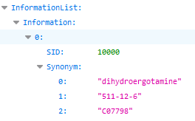
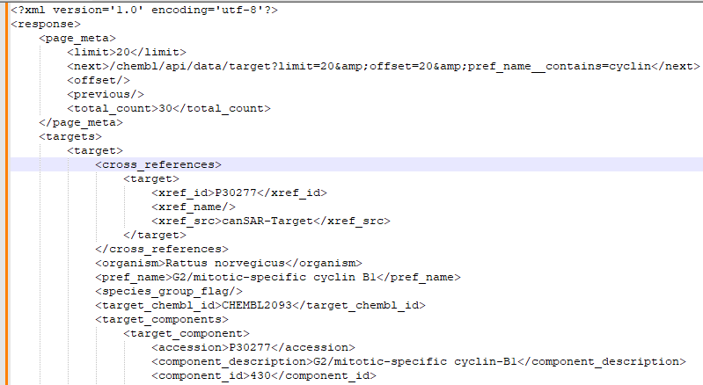
How software architecture defines boundaries and APIs bridge them
API – REST Example - Browser
pubchem - searching for synonyms
https://pubchem.ncbi.nlm.nih.gov/rest/pug/substance/sid/10000/synonyms/json
protocol
server
path
ChEMBL - searching for molecules with name pattern
https://www.ebi.ac.uk/chembl/api/data/target?pref_name__contains=cyclin
protocol
server
path
parameter
https://pubchem.ncbi.nlm.nih.gov/docs/pug-rest-tutorial
https://www.ebi.ac.uk/chembl/ws

Slide 28
How software architecture defines boundaries and APIs bridge them
API – REST Example javascript and python
The request method is also defined in the header
GET : Used to receive information
POST: send information to server
PUT: update information on server
DELETE: remove information on server
HTTP Request
Contains information like IP address, server, accepted data formats, …
Request line
Header
context specific information like parameters
Message

Slide 29
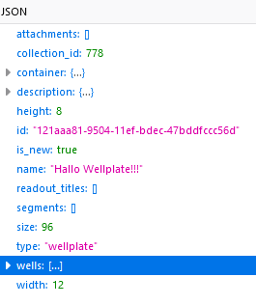
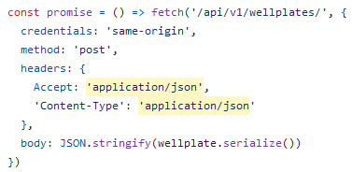
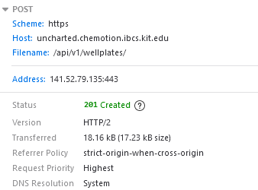
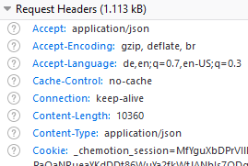
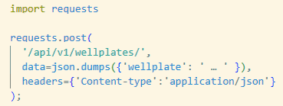
How software architecture defines boundaries and APIs bridge them
API – REST Example javascript and python
HTTP Request
Contains information like IP address, server, accepted data formats, …
The request method is also defined in the header
GET : Used to receive information
POST: send information to server
PUT: update information on server
DELETE: remove information on server
Request line
Header
context specific information like parameters
Message
Both create
Example java script
Example python

Slide 30

How software architecture defines boundaries and APIs bridge them
API – REST Example
https://pubchem.ncbi.nlm.nih.gov/rest/pug/substance/sid/10000/synonyms/json
https://www.ebi.ac.uk/chembl/api/data/target?pref_name__contains=cyclin
But how do i know what paths or parameters i have to enter ???

Slide 31
How software architecture defines boundaries and APIs bridge them
API – Open API
https://pubchem.ncbi.nlm.nih.gov/rest/pug/substance/sid/10000/synonyms/json
https://www.ebi.ac.uk/chembl/api/data/target?pref_name__contains=cyclin
But how do i know what paths or parameters i have to enter ???
Many but not all web services offer sufficient API documentation and they vary in form and quality
https://www.openapis.org/

Slide 32
How software architecture defines boundaries and APIs bridge them
API – Open API
https://pubchem.ncbi.nlm.nih.gov/rest/pug/substance/sid/10000/synonyms/json
https://www.ebi.ac.uk/chembl/api/data/target?pref_name__contains=cyclin
But how do i know what paths or parameters i have to enter ???
OpenAPI
The OpenAPI Specifications provides a formal standard for describing HTTP APIs
https://www.openapis.org/

Slide 33
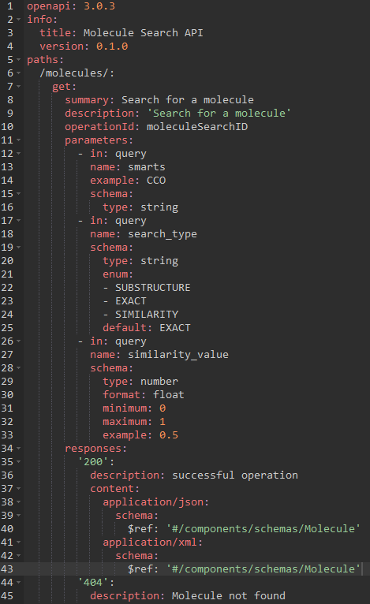
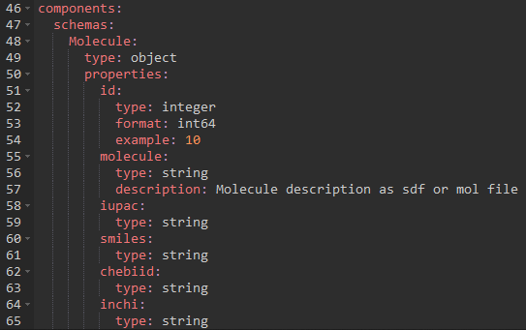
How software architecture defines boundaries and APIs bridge them
API – Open API Specification 3.0

Slide 34
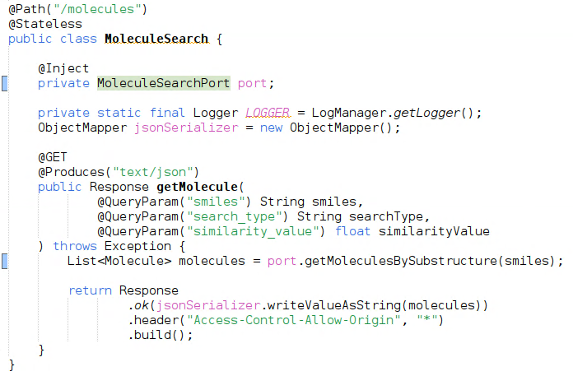
How software architecture defines boundaries and APIs bridge them
API – Open API Specification 3.0

Slide 35
How software architecture defines boundaries and APIs bridge them
API – Open API Specification 3.0
What's in here for me???

Slide 36
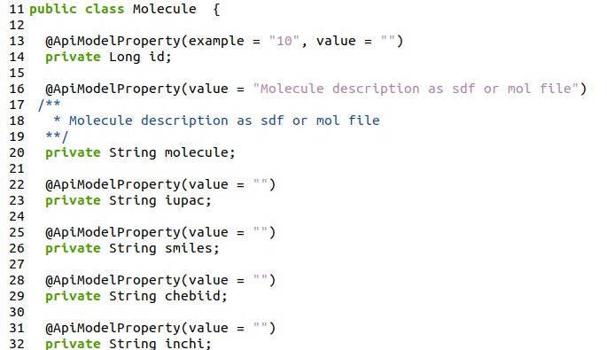
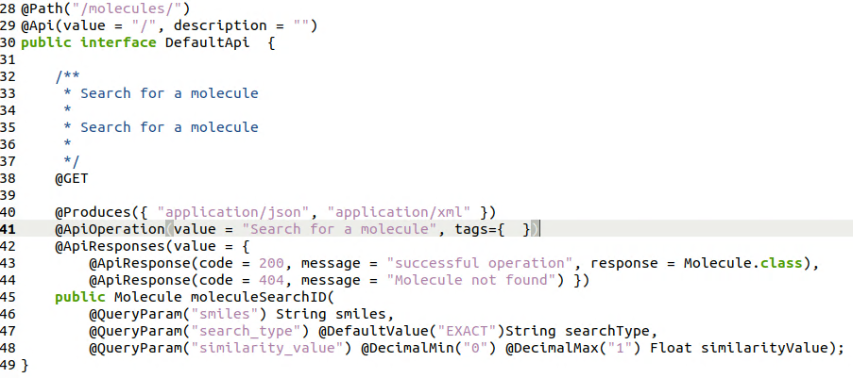
How software architecture defines boundaries and APIs bridge them
API – Open API – code generator
Automatic code generation
Automatic code generation for clients and servers for various languages
Automatic documentation generation for different styles
Even database shemas could be generated
Automatically generated java REST server endpoint
https://openapi-generator.tech/

Slide 37
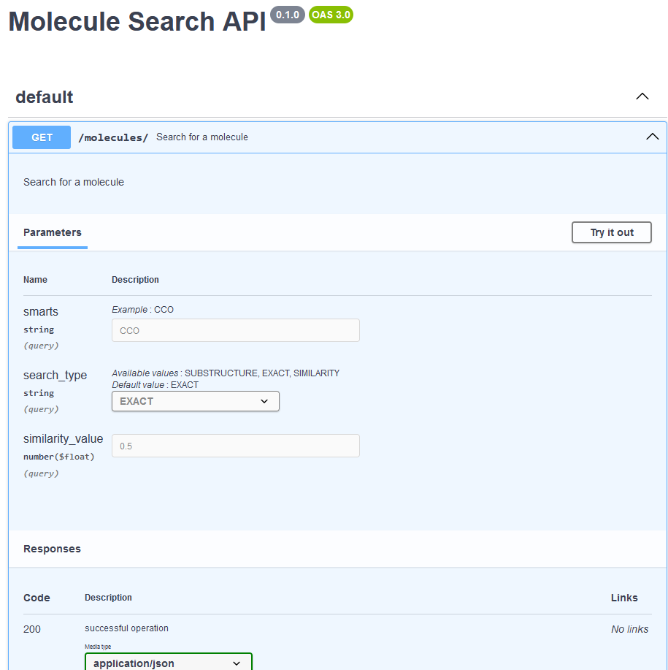
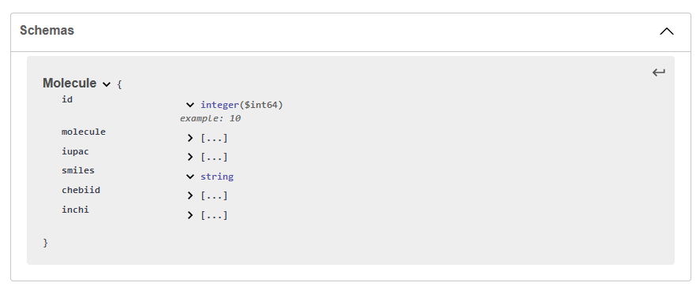
How software architecture defines boundaries and APIs bridge them
API – Open API – documentation
Out of the box documentation
Extensive documentation of the API routes
Detailed description of the data resources
Playground for trying out the API
Ways to simulate various security mechanisms
https://editor.swagger.io/

Slide 38
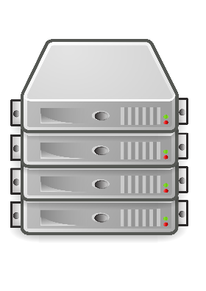
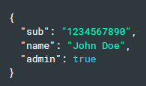
How software architecture defines boundaries and APIs bridge them
API – Securing API endpoints
Application
HTTP, REST
Authentication and Authorization
Enter credentials
User
Presentation
API Access Token
API Access Token
Session
TLS
Encryption
data
…
JSON Web Token (JWT)
Compact, URL-safe representation of claims between 2 parties
OSI Layer Model
xxxx.yyyy.zzzz
Authentification < > Authorisation
Header: defines type of token and signing algorithm
Payload: contains the claims
Signature: Signature for validation
Who
What
More sophisticated mechanisms:
OAuth2.0 , OpenID connect, …
M.Jones, J. Bradley,N. Sakimura, https://datatracker.ietf.org/doc/html/rfc7519, 2015
M. Amundsen, Design and Build Great Web APIs, 2020, p. 207ff

Slide 39
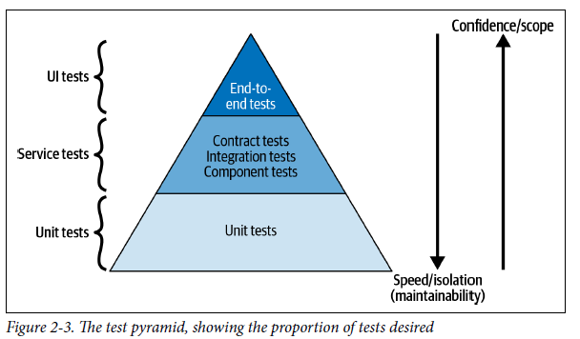
How software architecture defines boundaries and APIs bridge them
API – Testing of APIs
Simulates a client and a hole usecase
Frameworks: Cypress, Playwright, …
By using the Hexagon architecture, components could be mocked
Using frameworks could help: testcontainers, virtual archives, …
Usually APIs are tested in upper layers
!! All tests in all layers must be executed automatically regardless of the environment !!
J. Gough, D Bryant, M Auburn, Mastering API Architecture,2023, S. 50

Slide 40
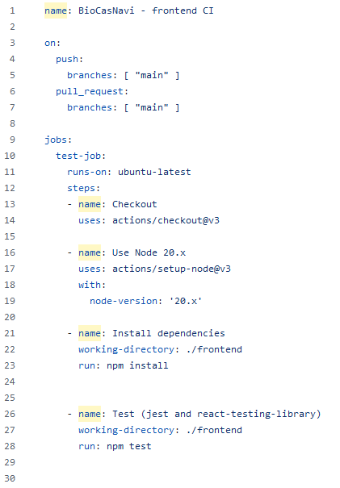
How software architecture defines boundaries and APIs bridge them
Testing with github actions
“… Automate, customize and execute your software development workflows directly in your repository.”
Workflow: configurable automated sequence of tasks
Event: specific occurrence in your repository that triggers a workflow
Job: collection of steps that are executed in a workflow
Action: individual building blocks of a workflow
Runner: computer on which your workflows are executed
Step: smallest executable unit in a job
https://docs.github.com/de/actions

Slide 41
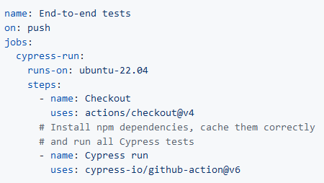
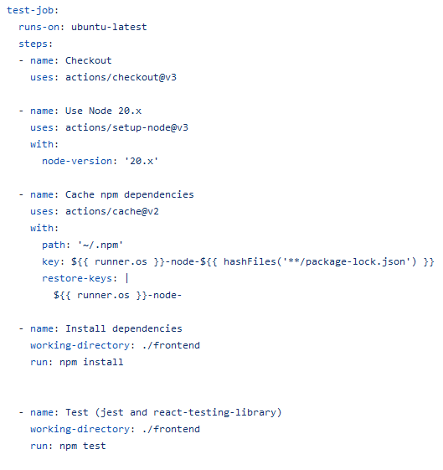
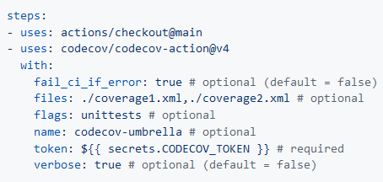
How software architecture defines boundaries and APIs bridge them
Github actions - examples
Hundreds of provided actions for many areas
cypress-io/github-action
codecov-action
https://github.com/sdras/awesome-actions

Slide 42
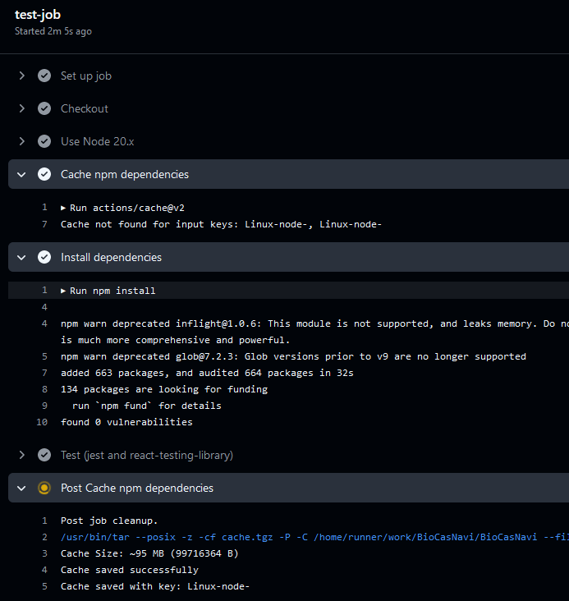
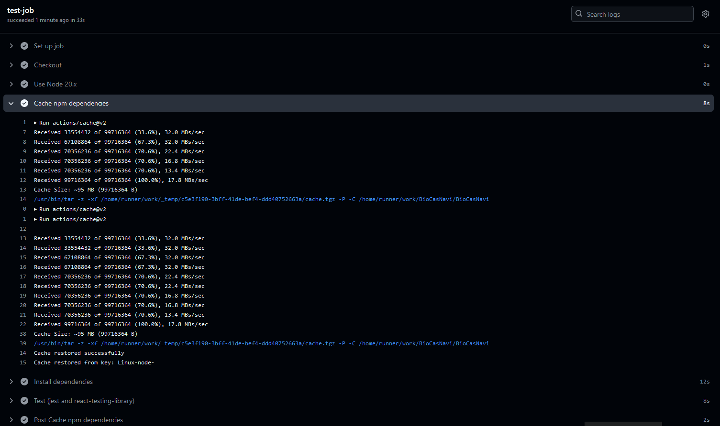
How software architecture defines boundaries and APIs bridge them
Github action - caching
Execution with cached dependencies
Workflow execution time : 33s vs. 3,6s
Execution without cached dependencies

Slide 43
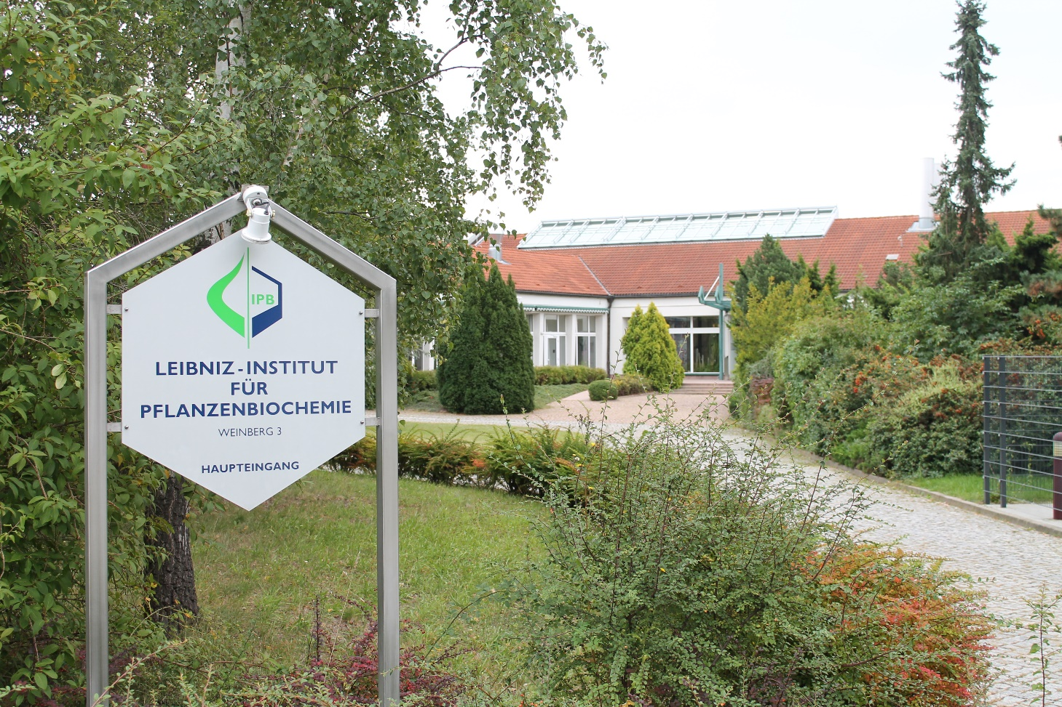

How software architecture defines boundaries and APIs bridge them
Thank you
I would like to thank
Prof. Ludger Wessjohann
Dr. Mehdi Davari
Dr. Frank Broda
NWC department & Dr. Steffen Neumanns group
Funded by

